Slide 1
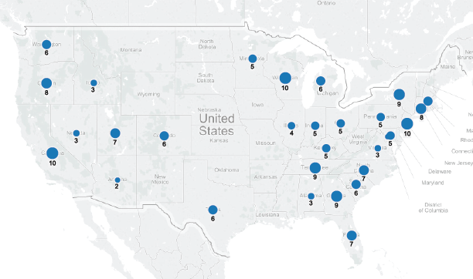
May Job Growth (+180K)

Slide 2
Iteration 1 (ADP vs BLS)

Slide 3
ADP vs. BLS
Monthly comparison
Button
Notes:
Correlation over entire period, mean absolute difference between both over entire period.
Change and vary time periods, and do correlation and mean absolute difference.

Slide 4
Monthly Comparison of ADP vs. BLS
Monthly comparison
Result of selecting button
Notes:
Change time periods for this.

Slide 5
Iteration 2 (ADP vs BLS)

Slide 6
ADP vs. BLS private payroll growth
Start:
End:
GO
Monthly Comparison
Month
Year
Month
Year
Time period: Jan ‘06 – May ‘16
Correlation: 0.98
Mean absolute error: 45k
Notes:
Correlation over entire period, mean absolute difference between both over entire period.
Change and vary time periods, and do correlation and mean absolute difference.

Slide 7
Monthly Comparison of ADP vs. BLS
Monthly Comparison
Start:
End:
Month
Year
Month
Year
GO
Notes:
Change time periods for this.

Slide 8
Iteration 3 (ADP vs BLS)

Slide 9
ADP vs. BLS private payroll growth
Start:
End:
GO
Monthly Comparison
Month
Year
Month
Year
Thous.
Time period: Jan ‘06 – May ‘16
Correlation: 0.98
Mean absolute error: 45k
Notes:
Correlation over entire period, mean absolute difference between both over entire period.
Change and vary time periods, and do correlation and mean absolute difference.

Slide 10
ADP vs. BLS private payroll growth
Start:
End:
GO
Monthly Comparison
Jan
2012
May
2016
Time period: Jan ‘12 – May ‘16
Correlation: 0.99
Mean absolute error: 30k
Notes:
Correlation over entire period, mean absolute difference between both over entire period.
Change and vary time periods, and do correlation and mean absolute difference.

Slide 11
Monthly Comparison of ADP vs. BLS
Monthly Comparison
Start:
End:
Month
Year
Month
Year
GO
Notes:
Change time periods for this.

Slide 12
Monthly Comparison of ADP vs. BLS
Monthly Comparison
Start:
End:
Jan
2012
May
2016
GO
Notes:
Change time periods for this.

Slide 13
Iteration 4 (ADP vs BLS)

Slide 14
ADP vs. BLS private payroll growth
Start:
End:
GO
Monthly Comparison
Month
Year
Month
Year
Thous.
Time period: Jan ‘06 – May ‘16
Correlation: 0.98
Mean absolute error: 45k
Notes:
Correlation over entire period, mean absolute difference between both over entire period.
Change and vary time periods, and do correlation and mean absolute difference.
Plot the error instead…(linked chart to below it that gives another cut)...Time series of the error (http://www.highcharts.com/demo/synchronized-charts)

Slide 15
ADP vs. BLS private payroll growth
Start:
End:
GO
Monthly Comparison
Jan
2012
May
2016
Time period: Jan ‘12 – May ‘16
Correlation: 0.99
Mean absolute error: 30k
Notes:
Correlation over entire period, mean absolute difference between both over entire period.
Change and vary time periods, and do correlation and mean absolute difference.

Slide 16
Monthly Comparison of ADP vs. BLS
Monthly Comparison
Start:
End:
Month
Year
Month
Year
GO
Notes:
Change time periods for this.

Slide 17
Monthly Comparison of ADP vs. BLS
Monthly Comparison
Start:
End:
Jan
2012
May
2016
GO
Notes:
Change time periods for this.

